Slide 1

Year 4
Multiplication Tables

Slide 2
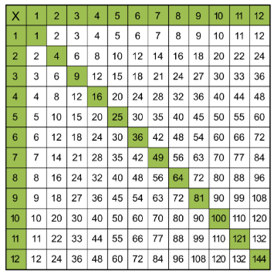
Bronze
x2, x5, x10
Silver
x3, x4, x8
Gold
x6, x7, x9
Platinum
x11, x12

Slide 3
If multiplication facts are learnt and stored, rather than being calculated or by skip counting repeatedly, then they will require less activity from the brain, reducing the ‘cognitive load’ and essentially ‘freeing up’ space to focus brain activity on the application of the facts NOT the facts themselves.
Dehaene, S. http://win.pisavisionlab.org/teaching/burr/piazzadehaene_chapgazzaniga.pdf

Slide 4
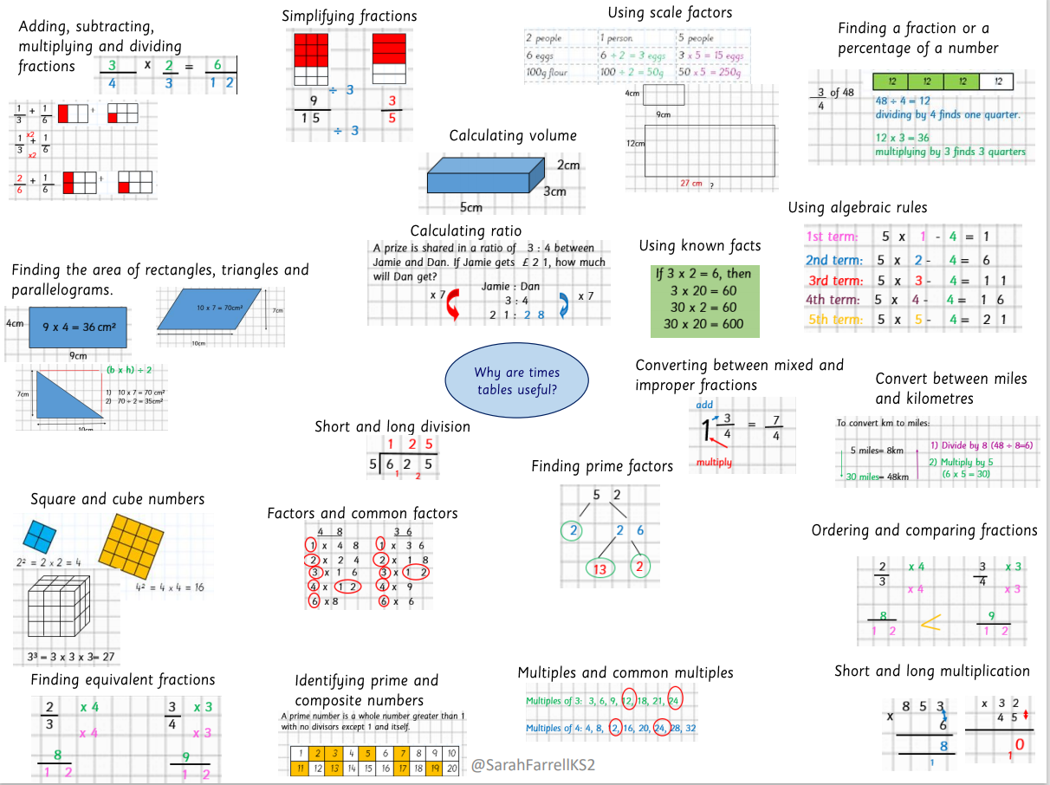
The importance of times tables
  Fractions
(adding/subtracting/multiplying/dividing/simplifying/ fraction of an amount/equivalent fractions/improper fractions and mixed numbers
  Square and cube numbers
  Prime and composite numbers
  Short and long division
  Short and long multiplication
  Scale factors
  Ratio
  Algebra
  Percentages
  Converting measures
  Area of rectangles, triangle and parallelograms
  Volume

Slide 5
Ways to support times table knowledge
  Count and look for patterns.
  Understand that multiplication is repeated addition.
  Remember that multiplication is commutative.
  Remember that multiplication is the inverse of division.
  Recall and utilise fact families.
Notes:
However, while quick recall of times tables is important, automacy isn’t the same as memorisation. Automatic recall of times tables can involve quick number skills and using nearby known facts (such as an understanding of commutativity).

Slide 6

Counting and looking for patterns
Example: Counting in 2s
2, 4, 6, 8, 10…
  Ensure children have a strong understanding of counting in groups first.
  When children are secure with counting, they can then look for patterns.
Notes:
Counting will start before beginning to develop understanding and reasoning but will continue long after, until all times tables can be counted through sequentially at speed.
Counting using manipulatives should start with physical objects (shoes, socks, hands etc) before moving on to counters etc
Whenever starting children counting in a new amount, such as counting in 8s, children should be given the opportunity to see visually what that looks like to reinforce 4 x 8 looks quite big compared to 4 x 6.
Patterns could be 4 x 8 is the same as 4 x 4 doubled.

Slide 7
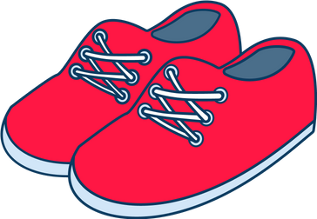

Repeated addition
Knowing that 2 x 4 is the same as 2 + 2 + 2 + 2
2 + 2 + 2 + 2 = ?
2 x 4 = ?
Notes:
Children need experience of using concrete manipulatives such as counters or multilink cubes and pictorial representations of objects, forming arrays.

Slide 8


Multiplication is commutative
3 x 2 is the same as 2 x 3
Children need to understand that multiplication can be completed in any order to produce the same answer. Sometimes this link needs to be made explicit.
3 lots of 2 = 6
2 lots of 3 = 6
Notes:
Children build on their existing understanding using arrays, turning the arrays around to show that you now have 2 groups of 3 and they will still total 6. This can then be linked to recalling multiplication facts, e.g. if they know their 2 times table as facts but not their 3 times table, they can use 2 x 3 to work out 3 x 2.

Slide 9

Multiplication is the inverse of division
20 ÷ 5 = 4 can be worked out because 5 x 4 = 20
Using pictorial representations (such as arrays) is useful here for children to see the link between multiplication and division.
Notes:
Even though division is not tested in the MTC, it is important that pupils have a strong understanding of the connection between multiplication and division.
Again, the use of arrays is key. Children need experience of pulling arrays apart into groups or sharing. After basic experience has been gained, the children should start to ‘see’ an array structure as 5 groups of 4 equal 20 and 20 can be split into 5 groups of 4.

Slide 10
Fact families
4 x 5 = 20, 5 x 4 = 20, 20 ÷ 5 = 4, 20 ÷ 4 = 5
Due to their commutative understanding, children should also be able to see whole number families. For many children this will need to be pointed out and discussed.
20
4
5
Notes:
From here it is only a short jump to understanding that any missing number can be worked out through knowledge of fact families, e.g. 4 x [ ] = 20 or [ ] ÷ 4 = 5. There are other methods children can use to work out missing numbers but our goal is to increase working memory in order to increase instant recall from long term memory. Being able to bounce around a fact family will achieve that.

Slide 11
Using known facts
4 x 6 = ?
I know 4 x 5 = 20
Therefore, 20 + 4 = 24
By using known facts from ‘easier’ times tables, children should be able to find answers with increasing speed.
+

Slide 12
Multiplicative facts are stored in our verbal memory; saying (and hearing) the sound pattern of the phrase (e.g. ‘seven threes are twenty-one’) is important.

Slide 13
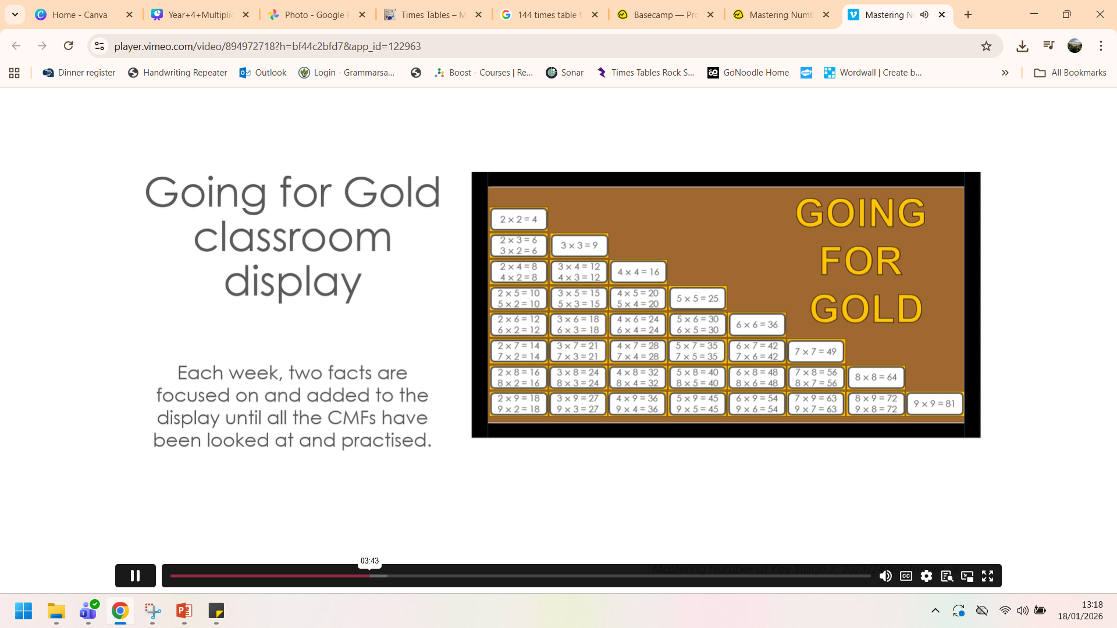
Mastering Number Year 4

Slide 14
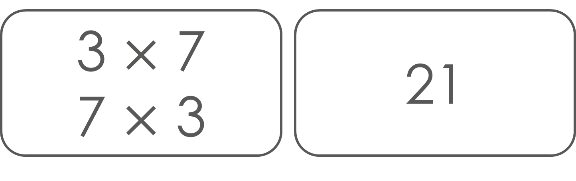
Factor, factor, product

Slide 15
Important information about multiplication tables check (MTC)
  The MTC determines if Year 4 children can fluently recall their multiplication tables.
  They are designed to help schools identify which children require more support to learn their times tables.
  There is no ‘pass’ rate or threshold which means that, unlike the Phonics Screening Check, children will not be expected to re-sit the check.
  The Department for Education (DfE) will create a report about the overall results across all schools in England, not individual schools.
Notes:
The test is designed to identify pupils who need support, not as a diagnostic tool to assess the times tables children struggle with.
https://www.gov.uk/government/collections/multiplication-tables-check

Slide 16
When the check will take place
  There will be a 2 week window from Monday 1 June 2026 for schools to administer the check.
  There is no set day to administer the check and children are not expected to take the check at the same time.
  All eligible Year 4 children in England will be required to take the check.
Notes:
It is up to individual schools to decide how the check is administered – some schools will administer individually while others will take small groups out or administer to the whole class.
A list of pupils who should not take the test can be found in the administration guidance of the MTC documentation.

Slide 17
How the check is carried out
  The check will be fully digital.
  Answers will be entered using a keyboard, by pressing digits using a mouse or using an on-screen number pad.
  Usually, the check will take less than 5 minutes for each child.
  The children will have 6 seconds from the time the question appears to input their answer.
  There will be a total of 25 questions with a 3 second pause in-between questions.
  There will be 3 practice questions before the check begins.
Notes:
Some children will be eligible for additional support (detailed in the next slide).
6 seconds per answer means that children must be able to read, recall and enter their response within that time. Whatever is written in the answer box at the end of 6 seconds will be counted as the answer i.e. if the student intends to write 144 and only 14 is typed when the timer ends, their recorded answer is 14.
Children are allowed to practise before taking the check.
https://mathsframe.co.uk/en/resources/resource/477/Multiplication-Tables-Check example showing how quick the questions are/ types of questions.

Slide 18
Specific arrangements for the check
Some children will be eligible for specific arrangements:
  Colour contrast;
  Font size adjustment;
  ‘Next’ button (alternative to 3-second pause);
  Removing on-screen number pad;
  An adult to input answers;
  Audio version;
  Audible time alert.
Notes:
Children eligible for access arrangements are:
Children with an EHC plan
Children who have provisions made in school using the SEND support system.
Children with behavioural, emotional or social difficulties
Children with EAL
Schools do not need to request permission to use access arrangements. The support should be based on the support provided in school and should not advantage or disadvantage individual children.
A child can be assigned more than one access arrangement, if required.
There is no opportunity for additional time.

Slide 19
The check questions
  Each child will be randomly assigned a set of questions
  There will only be multiplication questions in the check, not division facts.
  The 6, 7, 8, 9 and 12 times tables are more likely to be asked.
  Reversal of questions (e.g. 8 x 6 and 6 x 8) will not be asked in the same check.
  Children will not see their individual results when they complete the check.
Notes:
Some questions will be repeated across different checks, but no more than 30% of questions will be repeated in any two checks. This means that if the check gets interrupted and children need to re-start it, they will only have a minimal advantage.
During the check pupils may be able to restart if certain conditions are met (e.g. a fire alarm).
The results will be sent to the schools when all the checks have been completed but it is then up to the school if they report the results or not.
There won’t be questions from the 1 times tables (although they might be included in the 3 practice questions).
There will be a maximum of 7 questions from the 2, 5 and 10 times tables.
There is a focus on the 6, 7, 8, 9 and 12 times tables as they are the ‘most difficult’ multiplication tables.

Slide 20

More information about the questions
The Standards and Testing Agency (STA) state that they are classifying the multiplication tables by the first number (multiplier) in the question.
For example, 8 x 3 would fall within the 8 times table.
7
Notes:
The table shows the minimum/ maximum number of questions from each times table that will be asked.

Slide 21
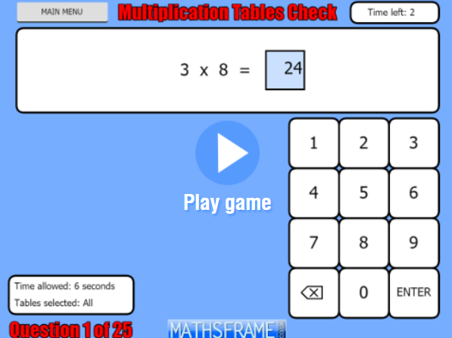
https://mathsframe.co.uk/en/resources/resource/477/Multiplication-Tables-Check

Slide 22
How best to prepare your child for the check
  Remind them that the check should last no more than 5 minutes.
  If you want to go over times tables, make them fun.
  If you have any concerns, talk to your child’s teacher.
  If your child has any concerns, encourage them to talk to a trusted adult (for example, yourself, their teacher).
Notes:
Games to try:
Climb the stairs counting in multiples
Play time tables games verbally.
Listen and sing along to times tables songs.
Take it in turns to say times tables in funny voices.
Play maths games online.

Slide 23
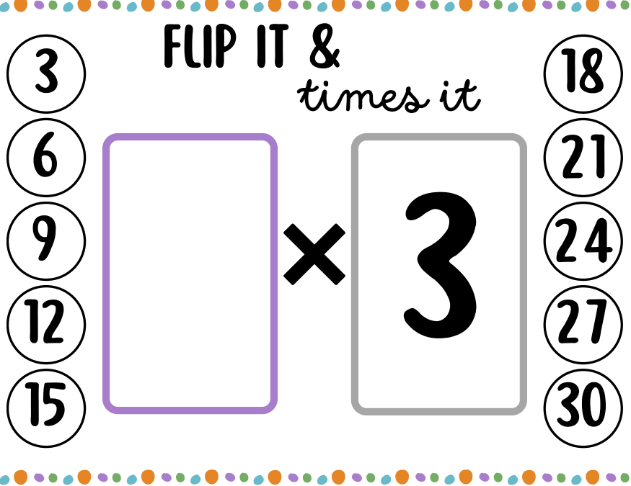
Times Table Activities
Flip it and times it

Slide 24
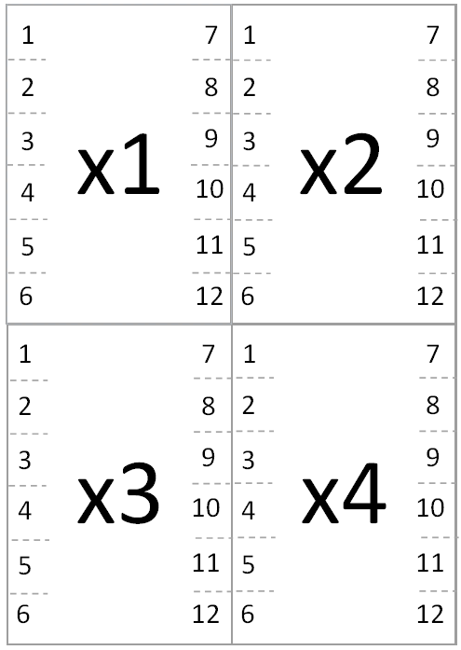
Times Table Activities
Times table flip cards

Slide 25
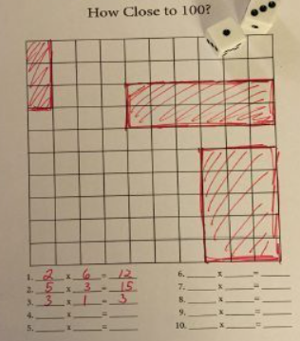
Times Table Activities
How close to 100?

Slide 26
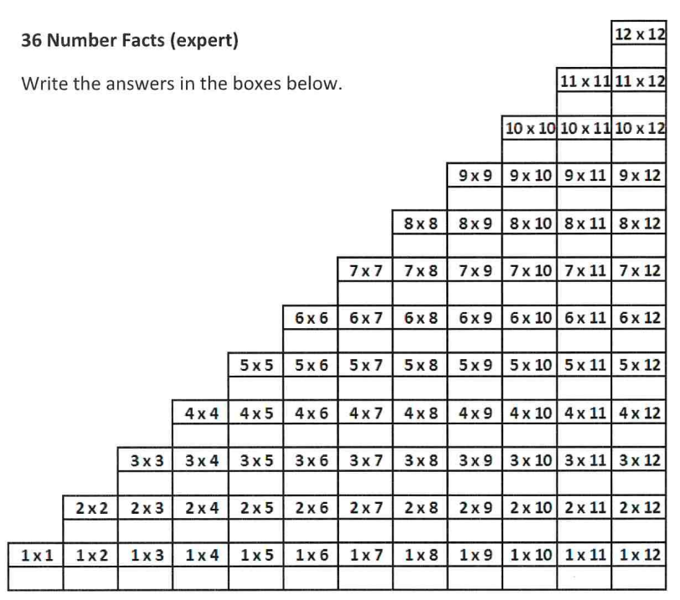
Times Table Activities
36 facts

Slide 27
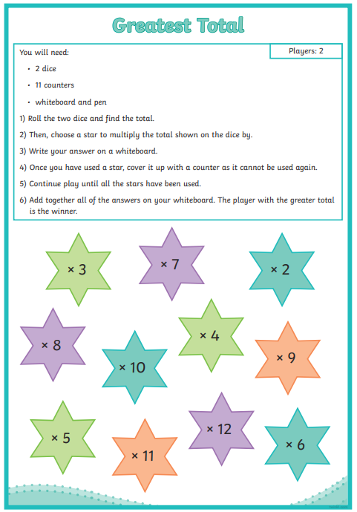
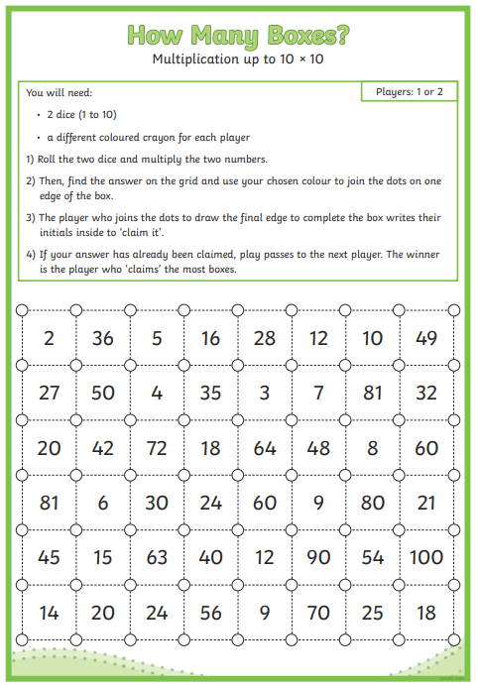
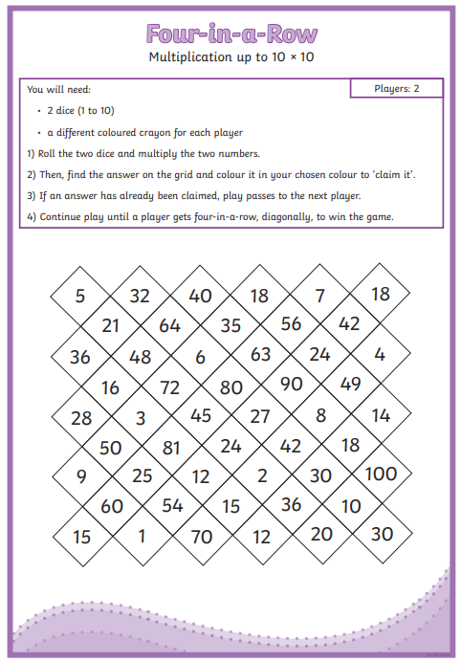
Times Table Activities
Greatest
Total
Four in a Row
How Many Boxes?

Slide 28
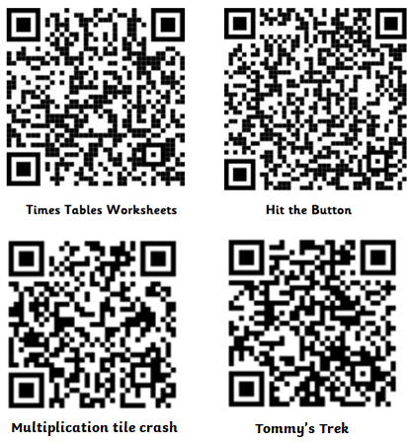
Times Table Activities
Interactive
Games

Slide 29

Please take the handouts to use at home and access any of the resources on the school website.

