Slide 1
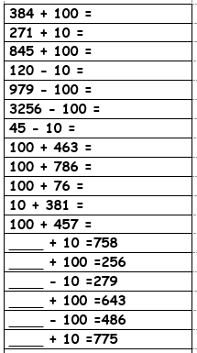
Year 3 – Spring 1
I can find 10 or 100 more or less than a given number.
For example:
245 + 10 =
520 – 100 =
Key Vocabulary
more / greater / count on
tens / hundreds
less / smaller / count back
digits change
Top Tips
The secret to success is practising little and often. Use time wisely. Can you practise these KIRFs while walking to school or during a car journey?
You could make a game : write a range of two and three digit numbers on small pieces of card or paper. Then write +10, +100, -10, -100 on separate pieces. Your child chooses one of each and calculates. You could set a timer to see how many they answer correctly in two minutes
Top Tips
WEBSITE:
https://www.topmarks.co.uk/maths-games/7-11-years/addition-and-subtraction

Slide 2
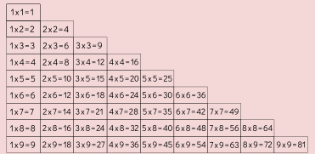
Year 4 – Spring 1
I know the multiplication and division facts for all times tables up to 12 × 12 .
Key Vocabulary
What is 12 multiplied by 6?
What is 7 times 8?
What is 84 divided by 7?
They should be able to answer these questions in any order, including missing number questions e.g. 7 × ⃝ = 28 or ⃝ ÷ 6 = 7.
Top Tips
The secret to success is practising little and often. Use time wisely. Can you practise these KIRFs while walking to school or during a car journey? You don’t need to practise them all at once: perhaps you could have a fact family of the day. If you would like more ideas, please speak to your child’s teacher.
Speed Challenge – Take two packs of playing cards and remove the kings. Turn over two cards and ask your child to multiply the numbers together (Ace = 1, Jack = 11, Queen = 12). How many questions can they answer correctly in 2 minutes? Practise regularly and see if they can beat their high score.
Online games – There are many games online which can help children practise their multiplication and division facts. www.conkermaths.org is a good place to start.
Use memory tricks – For those hard-to-remember facts, www.multiplication.com has some strange picture stories to help children remember.

