Slide 1
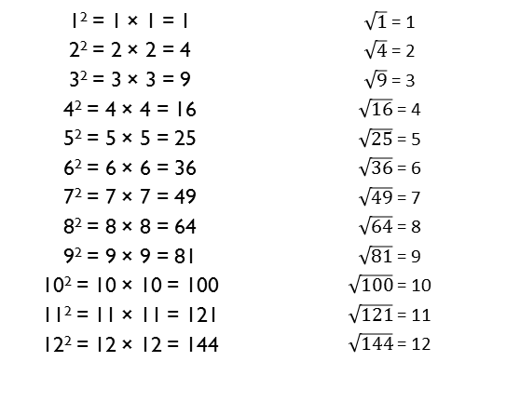
Year 5 – Spring 1
I can recall square numbers up to 12² and their square roots.
1² = 1 × 1 = 1 2² = 2 × 2 = 4 3² = 3 × 3 = 9 4² = 4 × 4 = 16 5² = 5 × 5 = 25 6² = 6 × 6 = 36 7² = 7 × 7 = 49 8² = 8 × 8 = 64 9² = 9 × 9 = 81 10² = 10 × 10 = 100 11² = 11 × 11 = 121 12² = 12 × 12 = 144 | $\sqrt{1}$ = 1 $\sqrt{4}$ = 2 $\sqrt{9}$ = 3 $\sqrt{16}$ = 4 $\sqrt{25}$ = 5 $\sqrt{36}$ = 6 $\sqrt{49}$ = 7 $\sqrt{64}$ = 8 $\sqrt{81}$ = 9 $\sqrt{100}$ = 10 $\sqrt{121}$ = 11 $\sqrt{144}$ = 12
Key Vocabulary
What is 8 squared?
What is 7 multiplied by itself?
What is the square root of 144?
Is 81 a square number?
Children should also be able to recognise whether a number below 150 is a square number or not.
Top Tips
The secret to success is practising little and often. Use time wisely. Can you practise these KIRFs while walking to school or during a car journey? You don’t need to practise them all at once: perhaps you could have a fact of the day. If you would like more ideas, please speak to your child’s teacher.
Cycling Squares – At http://nrich.maths.org/1151 there is a challenge involving square numbers. Can you complete the challenge and then create your own examples?
Use memory tricks – For those hard-to-remember facts, www.multiplication.com has some strange picture stories to help children remember.

Slide 2
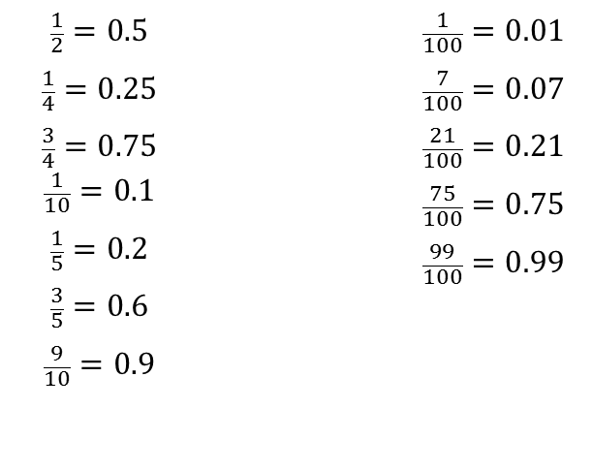
Year 6 – Spring 1
I can convert between decimals, fractions and percentages.
$$\frac{1}{2}=0.5$$ $$\frac{1}{4}=0.25$$ $$\frac{3}{4}=0.75$$ $$\frac{1}{10}=0.1$$ $$\frac{1}{5}=0.2$$ $$\frac{3}{5}=0.6$$ $$\frac{9}{10}=0.9$$ |  | $$\frac{1}{100}=0.01$$ $$\frac{7}{100}=0.07$$ $$\frac{21}{100}=0.21$$ $$\frac{75}{100}=0.75$$ $$\frac{99}{100}=0.99$$
Key Vocabulary
How many tenths is 0.8?
How many hundredths is 0.12?
Write 0.75 as a fraction?
Write ¼ as a decimal?
Children should be able to convert between decimals and fractions for ½, ¼, ¾ and any number of tenths and hundredths.
Top Tips
The secret to success is practising little and often. Use time wisely. Can you practise these KIRFs while walking to school or during a car journey? You don’t need to practise them all at once: start with tenths before moving on to hundredths. If you would like more ideas, please speak to your child’s teacher.
Play games - Make some cards with pairs of equivalent fractions and decimals. Use these to play the memory game or snap. Or make your own dominoes with fractions on one side and decimals on the other.

